Slide 1



Database management system
Group-11 (Budget Application)

Slide 2
Group Members
EMRE TOPCU
İSMAİL TEMÜROĞLU
DENİZ EREN ARICI
BURAK DERE
UMUT ALTUN
MUHARREM KOCABIYIK

Slide 3
Who Is our target audIence?
Our app targets a wide range from young adults seeking basic tools to busy families and investors needing advanced features. But mainly, our app targets those who want their financial independence and want to take charge of their financial status.

Slide 4
What is OUR MISSION STATEMENT?
Our mission is to enable people and businesses to attain financial well-being by providing them with smart budget analysis and effective management.

Slide 5
What did we do for our goal?
We designed a database that keeps User, Goal, Payment Method, Budget, Expense, Expense Category, Income information in a responsive database with related MYSQL queries.

Slide 6
Fact Finding Techniques
Research
We have searched for similar application databases in order to find similarities and key concepts of budget management application.
Survey
We made a survey in order to understand users financial habits and preferences to create a user-friendly and effective tool for managing their money.

Slide 7
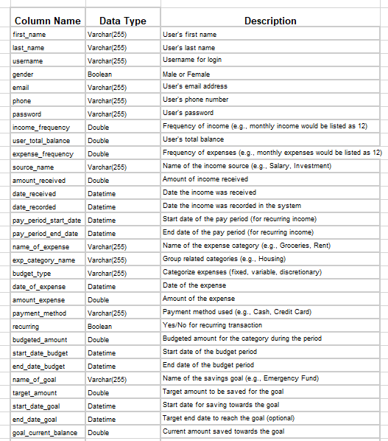

Slide 8
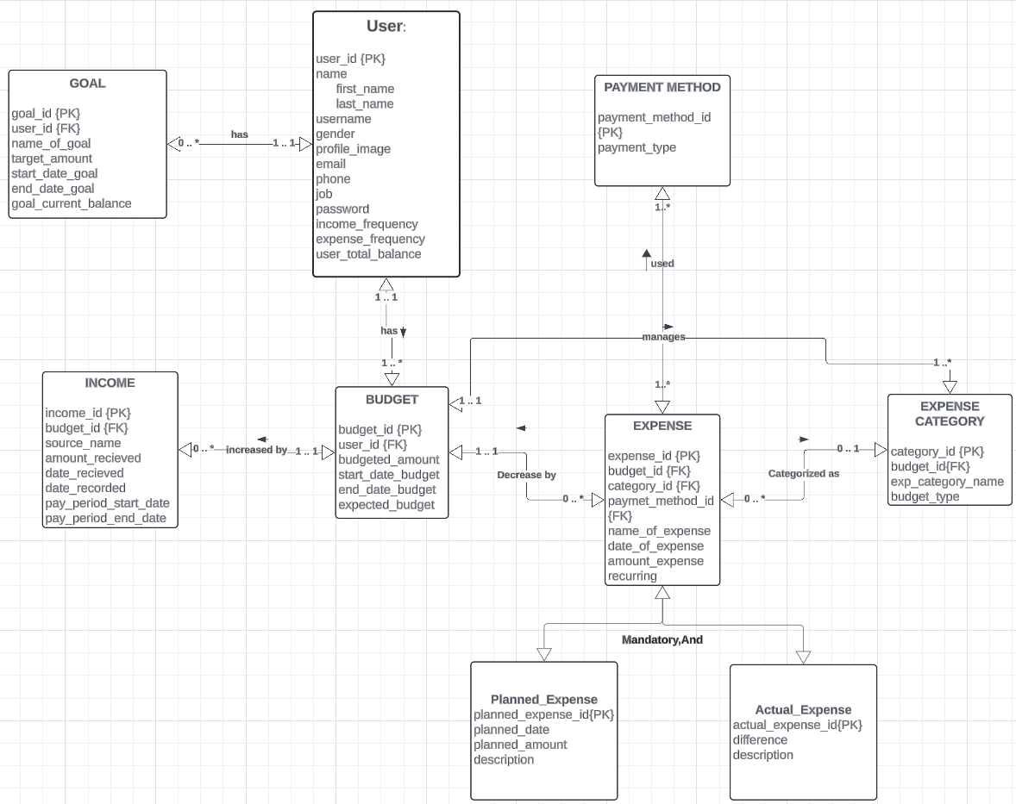
Our er dıagram

Slide 9
SQL QUERIES TO CREATE TABLE

Slide 10
USER
CREATE TABLE User AS
SELECT first_name, last_name,
username, gender,email,
phone, password, income_frequency, expense_frequency , user_total_balance
FROM UNF;
ALTER TABLE User
ADD COLUMN profile_image MEDIUMBLOB,
ADD COLUMN job VARCHAR(255),
ADD COLUMN user_id BIGINT NOT NULL PRIMARY KEY AUTO_INCREMENT;
ALTER TABLE User
ADD UNIQUE (username);
ALTER TABLE UNF
DROP COLUMN first_name,last_name, username, gender,email,
phone, password, income_frequency, expense_frequency , user_total_balance;

Slide 11
Goal
CREATE table goal AS
SELECT name_of_goal, target_amount, start_date_goal, end_date_goal, goal_current_balance
from unf;
ALTER table goal
ADD COLUMN user_id BIGINT NOT NULL,
ADD COLUMN goal_id bigint not null PRIMARY key AUTO_INCREMENT;
ALTER TABLE goal ADD CONSTRAINT user_id FOREIGN KEY (user_id) REFERENCES user(user_id) ON UPDATE CASCADE;
ALTER TABLE UNF DROP COLUMN name_of_goal, target_amount, start_date_goal, end_date_goal, goal_current_balance;

Slide 12
budget
CREATE TABLE Budget AS
SELECT budgeted_amount, start_date_budget,
end_date_budget
FROM UNF;
ALTER TABLE Budget
ADD COLUMN user_id BIGINT NOT NULL,
ADD COLUMN budget_id BIGINT NOT NULL AUTO_INCREMENT PRIMARY KEY,
ADD COLUMN expected_budget INT;
ALTER TABLE Budget
ADD CONSTRAINT PK_budget_user_id FOREIGN KEY (user_id) REFERENCES User (user_id) ON UPDATE CASCADE;
ALTER TABLE UNF DROP COLUMN budgeted_amount, start_date_budget,end_date_budget ;

Slide 13
ıncome
CREATE TABLE income AS SELECT source_name, date_received, date_recorded, pay_period_start_date, pay_period_end_date,amount_received FROM UNF;
ALTER TABLE income
ADD COLUMN income_id bigint NOT NULL AUTO_INCREMENT PRIMARY KEY,
ADD COLUMN budget_id BIGINT NOT NULL;
ALTER TABLE INCOME ADD CONSTRAINT FK_income_budget_id FOREIGN KEY (budget_id) REFERENCES Budget (budget_id) ON UPDATE CASCADE;
ALTER TABLE UNF DROP COLUMN source_name, date_received, date_recorded, pay_period_start_date, pay_period_end_date,amount_received;

Slide 14
EXPENSE CATEGORY
CREATE TABLE Expense_Category AS
SELECT budget_type, exp_category_name
FROM UNF;
ALTER TABLE Expense_Category
ADD COLUMN category_id BIGINT NOT NULL AUTO_INCREMENT PRIMARY KEY,
ADD COLUMN budget_id BIGINT NOT NULL,;
ALTER TABLE Expense_Category ADD CONSTRAINT FK_expense_category_budget_id FOREIGN KEY (budget_id) REFERENCES Budget (budget_id) ON UPDATE CASCADE;
ALTER TABLE UNF DROP COLUMN budget_type, exp_category_name;

Slide 15
EXPENSE
CREATE TABLE Expense AS
SELECT name_of_expense, date_of_expense, amount_expense,payment_method, recurring
FROM UNF;
ALTER TABLE Expense
ADD COLUMN category_id BIGINT,
ADD COLUMN budget_id BIGINT NOT NULL,
ADD COLUMN payment_method_id BIGINT NOT NULL,
ADD COLUMN expense_id BIGINT NOT NULL AUTO_INCREMENT PRIMARY KEY;
ALTER TABLE expense
ADD CONSTRAINT FK_exps_cat_id FOREIGN KEY (category_id) REFERENCES Expense_Category (category_id) ON DELETE SET NULL;
ALTER TABLE expense
ADD CONSTRAINT FK_budget_id FOREIGN KEY (budget_id) REFERENCES Budget (budget_id);
ALTER TABLE expense
ADD CONSTRAINT FK_payment_method_id FOREIGN KEY (payment_method _id) REFERENCES Payment_Method(payment_method_id);

Slide 16
Planned Expense
CREATE TABLE Planned_Expense (
planned_date DATE,
planned_amount INT,
description varchar(255),
planned_expense_id BIGINT AUTO_INCREMENT PRIMARY KEY,
expense_id BIGINT NOT NULL);
ALTER TABLE Planned_Expense
ADD CONSTRAINT FK_expense_id FOREIGN KEY (expense_id) REFERENCES Expense (expense_id) ON UPDATE CASCADE;

Slide 17
ACTUAL EXPENSE
CREATE TABLE Planned_Expense (
difference DOUBLE,
description varchar(255),
actual_expense_id BIGINT AUTO_INCREMENT PRIMARY KEY,
expense_id BIGINT NOT NULL);
ALTER TABLE Actual_Expense
ADD CONSTRAINT FK_expense_id FOREIGN KEY (expense_id) REFERENCES Expense (expense_id) ON UPDATE CASCADE;

Slide 18
PAYMENT METHOD
CREATE TABLE Payment_Method (
payment_method_id BIGINT NOT NULL AUTO_INCREMENT PRIMARY KEY,
payment_type varchar(255));

Slide 19
DROPPING UNF
DROP TABLE UNF;

Slide 20
Tasks given to us
List all planned expenses for the next month
Show total amount spent per month on each category for the previous year
Change an amount budgeted for a particular expense
Add a new budget expectation for next month based on previous month's expenses
Remove a category from the database

Slide 21
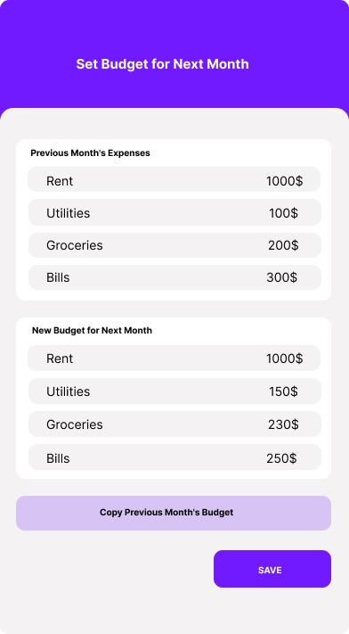

1. List all planned expenses for the next month
SELECT
name_of_expense, planned_amount, planned_date
FROM
Expense, Planned_Expense
WHERE
Expense.expense_id = Planned_Expense.expense_id
AND MONTH(planned_date) = MONTH(CURDATE() + INTERVAL 1 MONTH)
AND YEAR(planned_date) = YEAR(CURDATE() + INTERVAL 1 MONTH);

Slide 22
2. Show total amount spent per month on each category for the previous year
SELECT exp_category_name, MONTHNAME(date_of_expense), SUM(amount_expense) AS total_spent
FROM Expense_Category,Expense
WHERE Expense_Category.category_id = Expense.category_id AND YEAR(date_of_expense) = YEAR(CURDATE() - INTERVAL 1 YEAR)
GROUP BY exp_category_name, MONTH(date_of_expense)
ORDER BY exp_category_name, MONTH(date_of_expense);

Slide 23
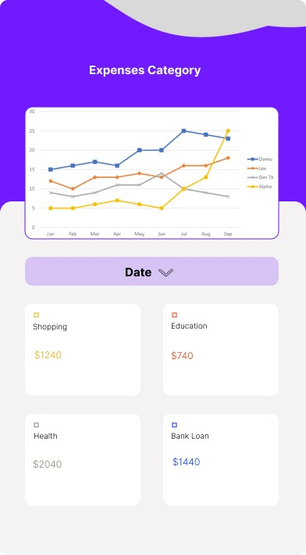

Slide 24
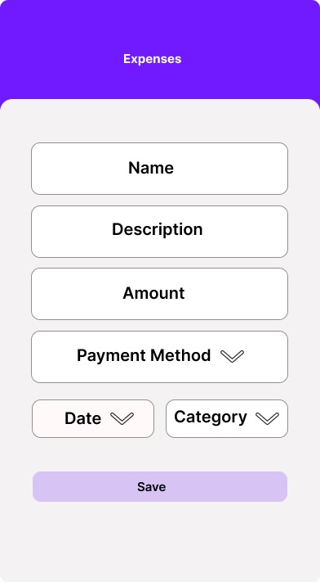
3. Change an amount budgeted for a particular expense
UPDATE Budget
SET budgeted_amount = /*Specified Amount*/
WHERE budget_id = (SELECT budget_id FROM Expense WHERE expense_id = /*Specified Expense*/);

Slide 25
4.1 Add a new budget expectation for next month based on previous month's expenses
SELECT exp_category_name, SUM(amount_expense) AS total_spent_last_month
FROM Expense_Category, Expense,Budget,User
WHERE budget.user_id = /* Specified User */ AND
User.user_id = budget.user_id AND
Expense.budget_id = budget.budget_id AND
Expense_Category.category_id = Expense.category_id AND
YEAR(date_of_expsense) = YEAR(CURDATE() - INTERVAL 1 MONTH) AND
MONTH(date_of_expsense) = MONTH(CURDATE() - INTERVAL 1 MONTH)
GROUP BY exp_category_name;

Slide 26
4.2 Add a new budget expectation for next month based on previous month's expenses
INSERT INTO Budget (user_id, budgeted_amount, start_date_budget, end_date_budget, expected_budget)
VALUES (user_id, total_spent_last_month, CURDATE() + INTERVAL 1 MONTH, CURDATE() + INTERVAL 2 MONTH, 'Planned');
INSERT INTO Expense (budget_id,category_id,payment_method_id,name_of_expense,date_of_expense,amount_expense,recurring)
VALUES(budget_id, category_id, payment_method_id, name_of_expense, CURDATE() + INTERVAL 1 MONTH, total_spent_last_month, recurring);

Slide 27
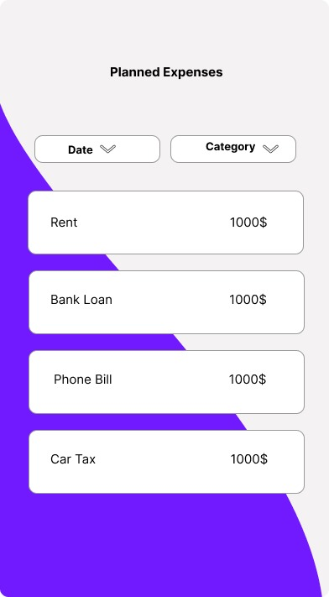

Slide 28
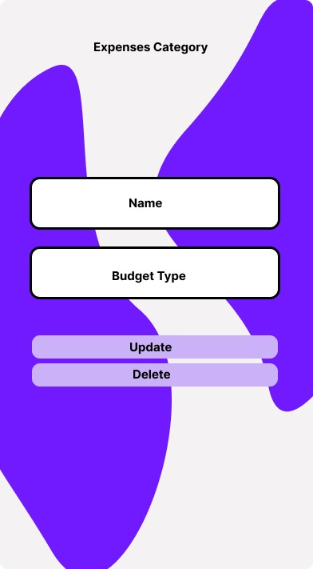
5. Remove a category from the database
DELETE FROM Expense_Category
WHERE category_id = /*Desired Category ID to Remove*/;

Slide 29
SOME OF THE Extra QUERIES OUR TEAM WANTED TO IMPLEMENT

Slide 30
Change username of a User.
UPDATE User
SET username = /*Desired Username*/
WHERE user_id = /*Desired UserID*/;

Slide 31
FOR A SPECIFIED USER, BUDGET LIST FOR RECENT YEAR
SELECT budget_id ,budgeted_amount
FROM Budget
WHERE Budget.user_id = /* Selected user */
AND DATEDIFF(CURDATE(),start_date_budget) <= 365;

Slide 32
Lıst all the ıncomes per specıfıc user Per Specıfıc AMOUNT Greater or equal than other
SELECT income_id,source_name,amount_received
FROM Income, Budget, User
WHERE Income.budget_id = Budget.budget_id AND Budget.user_id = User.user_id AND User.user_id = /*Specified User*/ AND Income.amount_received >= /* Specified Amount */
ORDER BY amount_received;

Slide 33
Thank you for your tıme!

